Slide 1

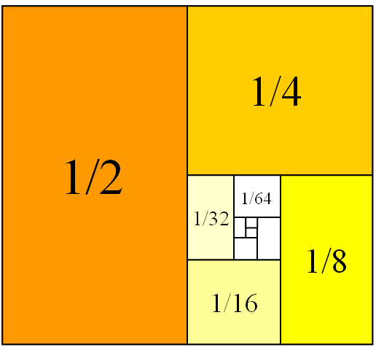
Mathematics for Engineering: Calculus
Chapter 1: Function and Graphs
Department of Mathematics, FPT University

Slide 2
Mathematics for Engineering: Calculus
Chapter 1: Function and Graphs
Objectives
Four ways to represent a function
Basis functions and the transformations of functions
Notes:
the importance of basic elementary functions, limits and continuity

Slide 3
FUNCTIONS AND GRAPHS
1.1
Review of Functions
Notes:
Understanding the interplay between the four ways of representing a function (verbally, numerically,…)
Find the domain and range
Determine even and odd function
Working with piecewise defined function

Slide 4
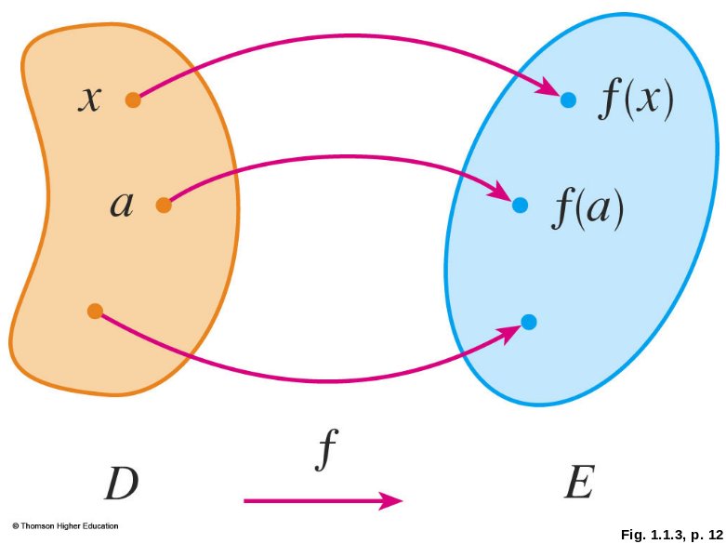
FUNCTION
A function f is a rule that assigns to each element x in a set D exactly one element, called f(x), in a set E.
The set D is called the domain of the function f.
The range of f is the set
of all possible values
of f(x) as x varies
throughout the domain.
Notes:
exactly one ; D, E in R; domain and range

Slide 5
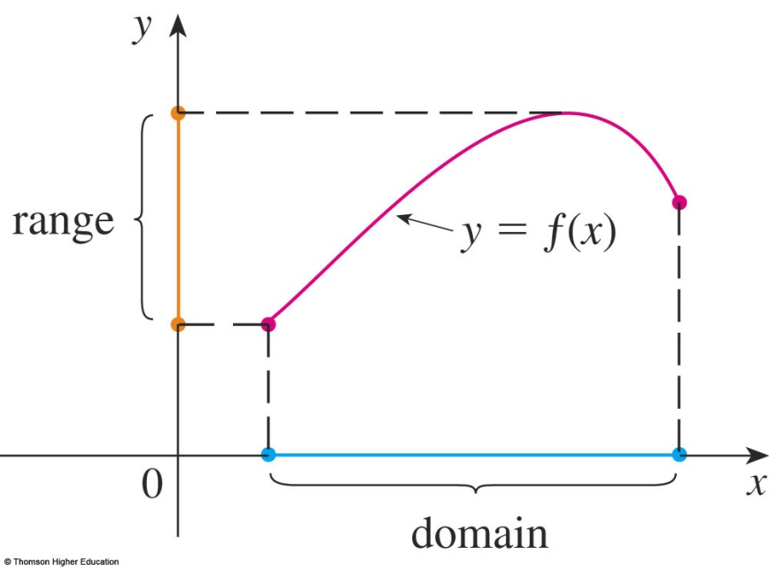
GRAPH
The graph of f is the set of all points (x, y) in the coordinate plane such that y = f(x) and x is in the domain of f.
The graph of f also allows us to picture:
  The domain of f on the x-axis
  Its range on the y-axis
Notes:
Perpendicular projection of the graph to the Ox is domain
Perpendicular projection of the graph to the Oy is range

Slide 6
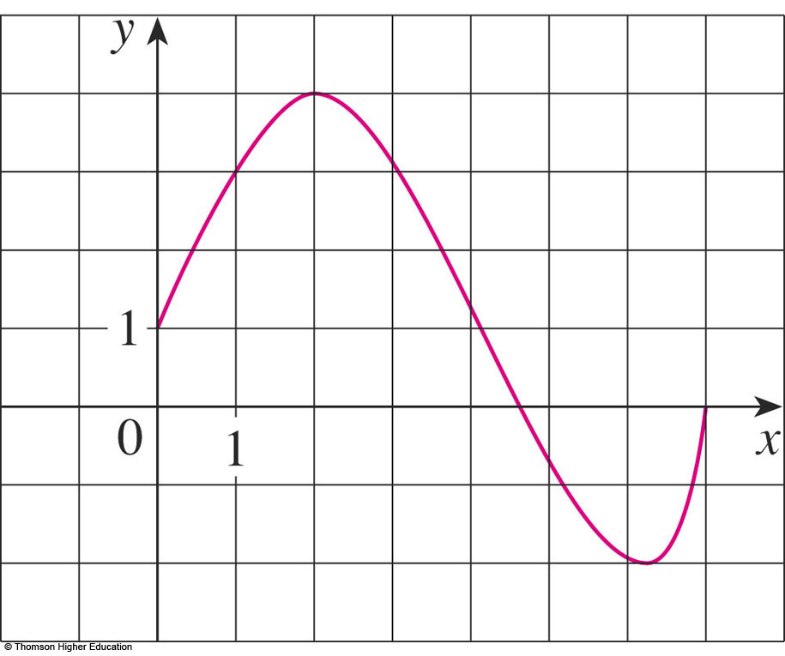
GRAPH
Example 1
The graph of a function f is shown.
Find the values of f(1) and f(5).
What is the domain and range of f ?
f(1) = 3
f(5) = - 0.7
D = [0, 7]
Range(f) = [-2, 4]

Slide 7
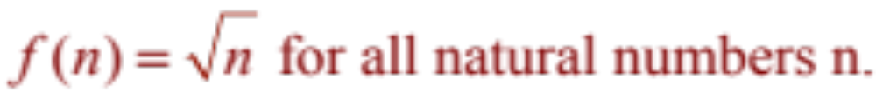
REPRESENTATIONS
DISCUSSION
Find the domain and region of the functions ( if it is a function).
a.
b.
Notes:
Any real number

Slide 8
REPRESENTATIONS OF FUNCTIONS
There are four possible ways to represent a function:
  Algebraically (by an explicit formula)
  Visually (by a graph)
  Numerically (by a table of values)
  Verbally (by a description in words)
Notes:
depending on situations where there is a suitable description

Slide 9
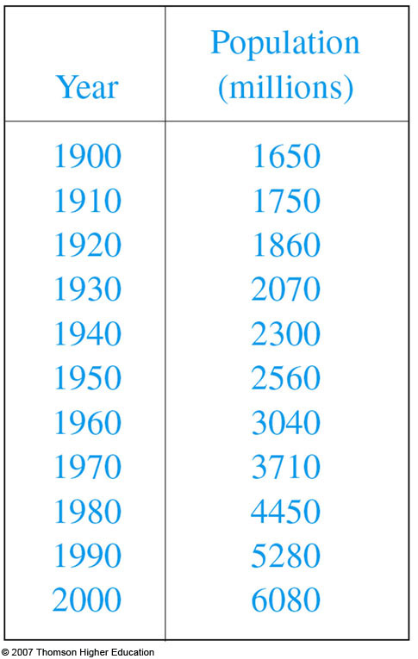
EXAMPLE
The human population of the world P depends on the time t.
  The table gives estimates of the
  world population P(t) at time t,
  for certain years.
  However, for each value of the
  time t, there is a corresponding
  value of P, and we say that
  P is a function of t.

Slide 10
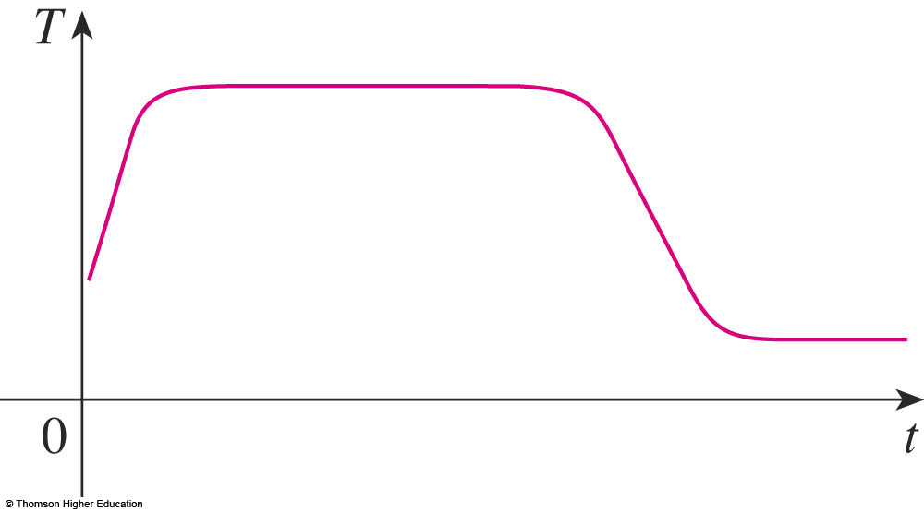
REPRESENTATIONS
Example
"When you turn on a hot-water faucet, the temperature T of the water depends on how long the water has been running".
Draw a rough graph of T as a function of the time t that has elapsed since the faucet was turned on.

Slide 11
THE VERTICAL LINE TEST
A curve in the xy-plane is the graph of a function of x if and only if no vertical line intersects the curve more than once.
Notes:
This test does not indicate the equation of the curve

Slide 12
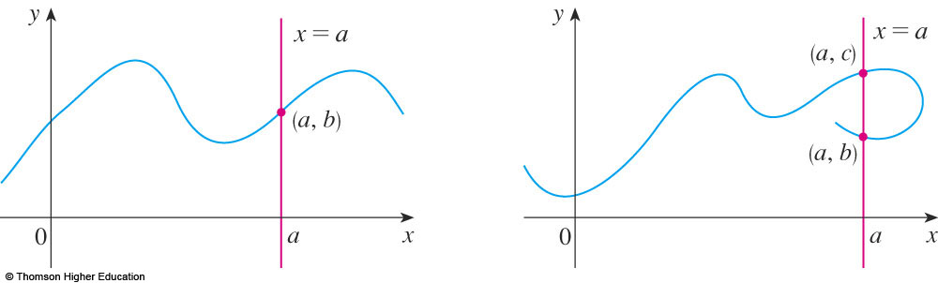
THE VERTICAL LINE TEST
The reason for the truth of the Vertical Line Test can be seen in the figure.

Slide 13
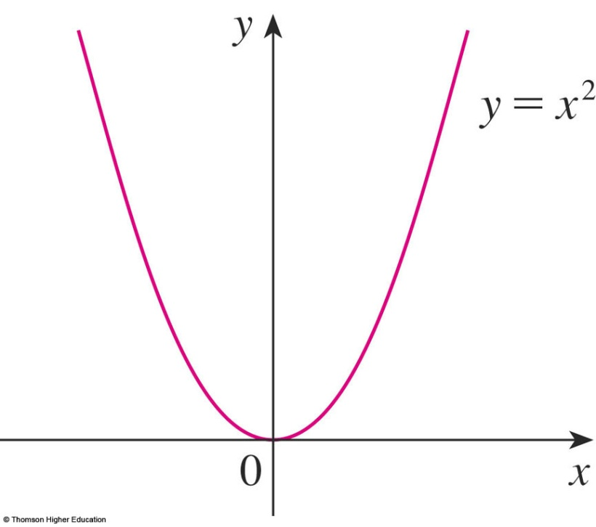
INCREASING AND DECREASING FUNCTIONS
A function f is called increasing on an interval I if:
f(x₁) < f(x₂) whenever x₁ < x₂ in I
It is called decreasing on I if:
f(x₁) > f(x₂) whenever x₁ < x₂ in I
Notes:
Monotonic

Slide 14
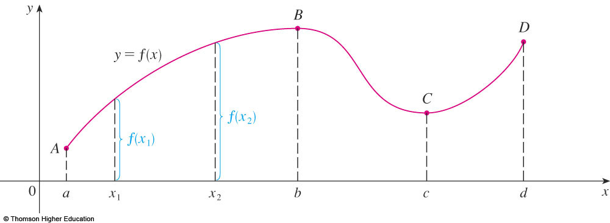
INCREASING AND DECREASING FUNCTIONS
The function f is said to be increasing on the interval [a, b], decreasing on [b, c], and increasing again on [c, d].

Slide 15
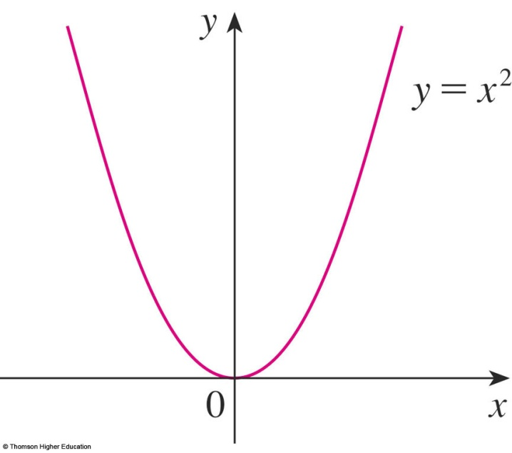
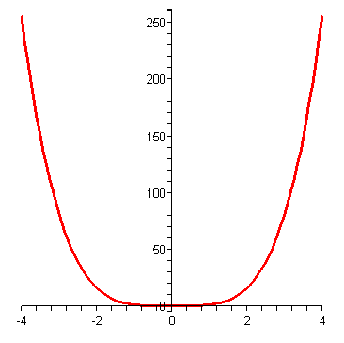
SYMMETRY: EVEN FUNCTION
If a function f satisfies:
f(-x) = f(x), for all x in D
then f is called an even function.
  The geometric significance of an even function is that its graph is symmetric with respect to the y-axis.
y = x⁴
Notes:
-x also in D

Slide 16
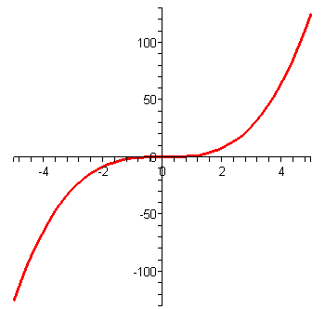
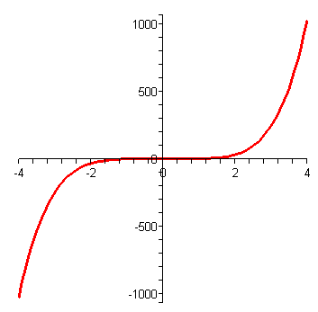
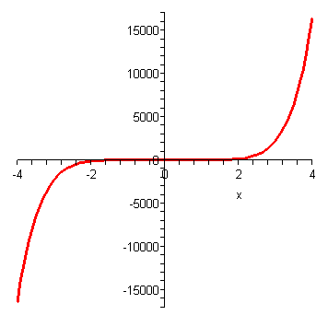
SYMMETRY: ODD FUNCTION
If f satisfies:
f(-x) = - f(x), for all x in D
then f is called an odd function.
  The graph of an odd function is symmetric about the origin.
y = x³
y = x⁵
y = x⁷
Notes:
-x also in D

Slide 17
Example
Let f is an odd function. If (-3,5) is in the graph of f then
which point is also in the graph of f?
a. (3,5) b. (-3,-5) c. (3,-5) d. All of the others
Answer: c

Slide 18
Example
Suppose f is an odd function and g is an even function.
What can we say about the function f.g defined by (f.g)(x)=f(x)g(x)?
Prove your result.
Notes:
Check (f.g) (-x) = ? (f.g)(x)

Slide 19
QUIZ QUESTIONS
If f is a function then f(x+2)=f(x)+f(2)
True b. False
2) If f(s)=f(t) then s= t
True b. False
3) Let f be a function.
We can find s and t such that s=t and f(s) is not equal to f(t)
a. True b. False

Slide 20
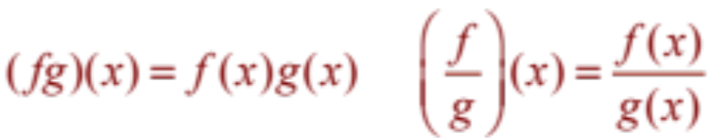
COMBINATIONS OF FUNCTIONS
Two functions f and g can be combined to form new functions:
  (f + g)x = f(x) + g(x)
  (f – g)x = f(x) – g(x)
  (f o g)(x) = f(g(x))
Notes:
Domain of new function

Slide 21
Let h(x)=f(g(x)).
If g(x)=x-1 and h(x)=3x+2 then f(x) is:
3x+3 b. 3x+4 c. 3x+1 d. None of them
2) If h(x)=3x+2 and f(x)=x-1 then g(x) is:
a. 3x+3 b. 3x+4 c.3x+1 d. None of them
Answer: 1) d 2) a

Slide 22
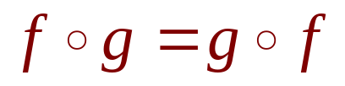


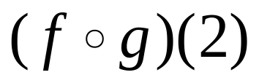
QUIZ QUESTIONS
If f and g are functions, then
True b. False
2)
is
a. 5 b. 1 c. 2 d. None of the others
x | 1 | 2 | 3 | 4 | 5 | 6
 | 3 | 2 | 1 | 0 | 1 | 2
 | 6 | 5 | 2 | 3 | 4 | 6
.

Slide 23
FUNCTIONS AND GRAPHS
1.2
BASIC CLASSES OF FUNCTIONS
Notes:
MODEL = FUNCTION

Slide 24
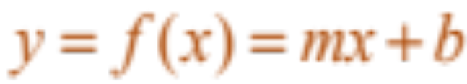
ALGEBRAIC FUNCTIONS
LINEAR MODELS
When we say that y is a linear function of x, we mean that the graph of the function is a line.
  So, we can use the slope-intercept form of the equation of a line to write a formula for the function as
  where m is the slope of the line and b is the y-intercept.
Notes:
the graph of the function is a line; meaning of slope and y - intercept

Slide 25
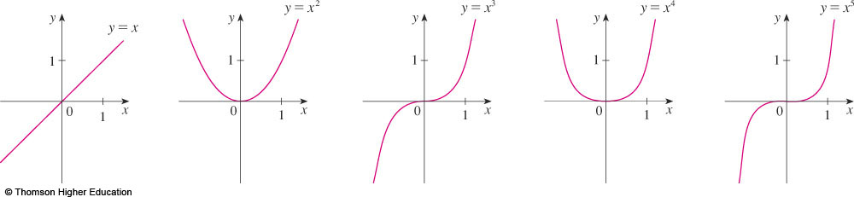
ALGEBRAIC FUNCTIONS
POWER FUNCTIONS
A function of the form f(x) = x ª , where a is constant, is called a power function.
Notes:
Domain?
Range?

Slide 26
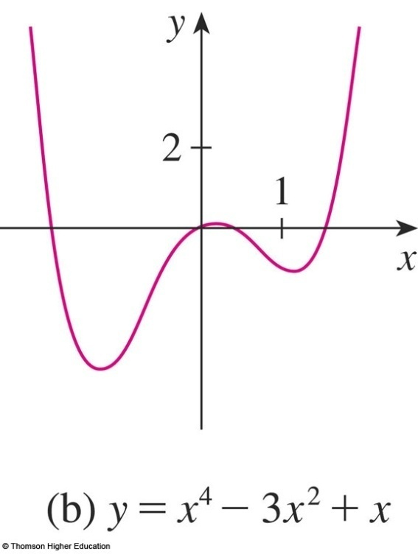
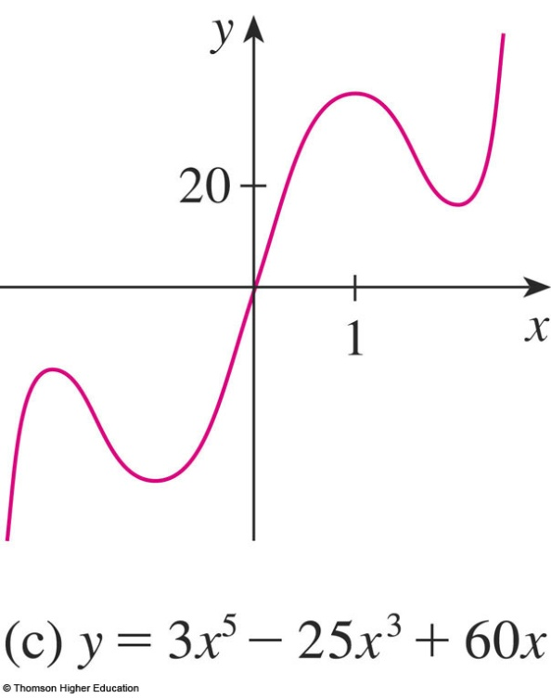
ALGEBRAIC FUNCTIONS
POLYNOMIALS
A function P is called a polynomial if
P(x) = a_{n}x^{n} + a_{n-1}x^{n-1} + … + a₂x² + a₁x + a₀
where n is a nonnegative integer and the numbers
a₀, a₁, a₂, …, a_{n} are constants called the coefficients of the polynomial.
Notes:
a_{n} ≠0

Slide 27
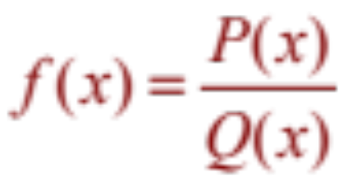
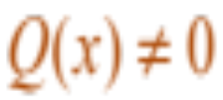
ALGEBRAIC FUNCTIONS
RATIONAL FUNCTIONS
A rational function f is a ratio of two polynomials
where P and Q are polynomials.
  The domain consists of all values of x
  such that .
Notes:
P and Q are polynomials

Slide 28
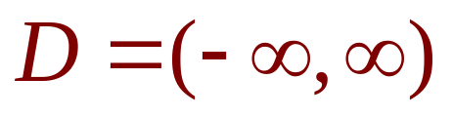
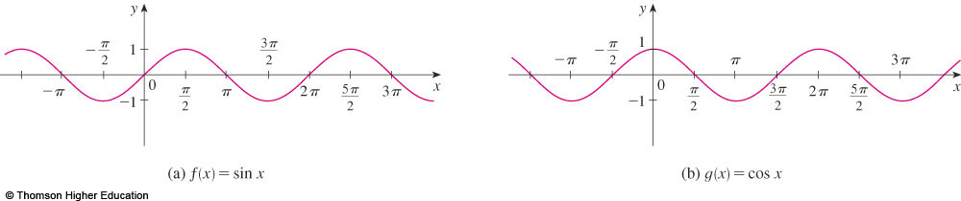
TRANSCENDENTAL FUNCTIONS
TRIGONOMETRIC FUNCTIONS
f(x) = sin x
g(x) = cos x
R = [-1, 1]
Notes:
Sin(-x)=sinx
Cos(-x) = cosx
R = [-1, 1]

Slide 29
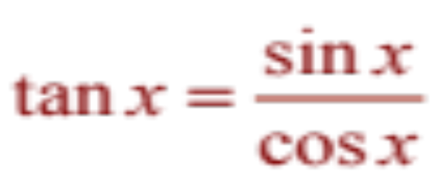
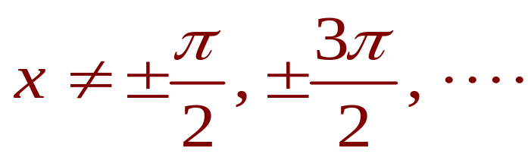
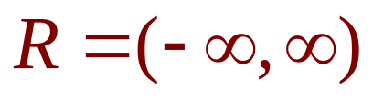

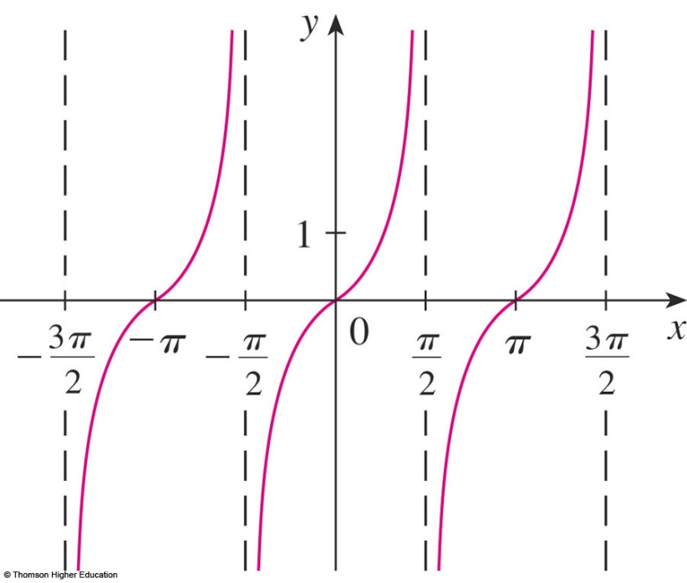
TRANSCENDENTAL FUNCTIONS
TRIGONOMETRIC FUNCTIONS
Notes:
Range = (-∞,∞)

Slide 30
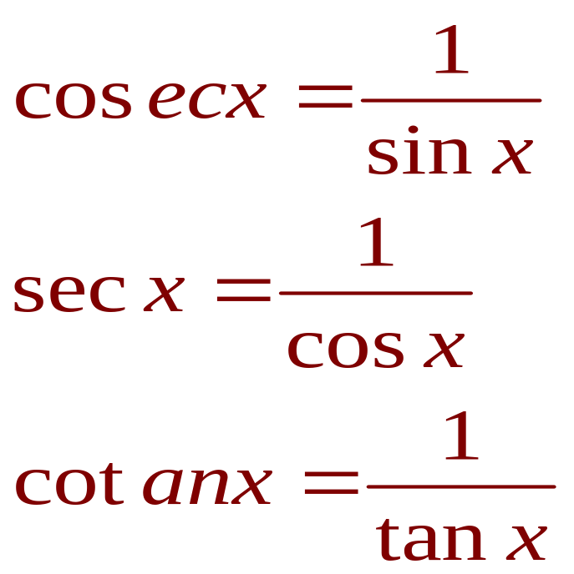
TRANSCENDENTAL FUNCTIONS
TRIGONOMETRIC FUNCTIONS
The reciprocals of the sine, cosine, and tangent functions are

Slide 31
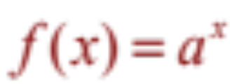


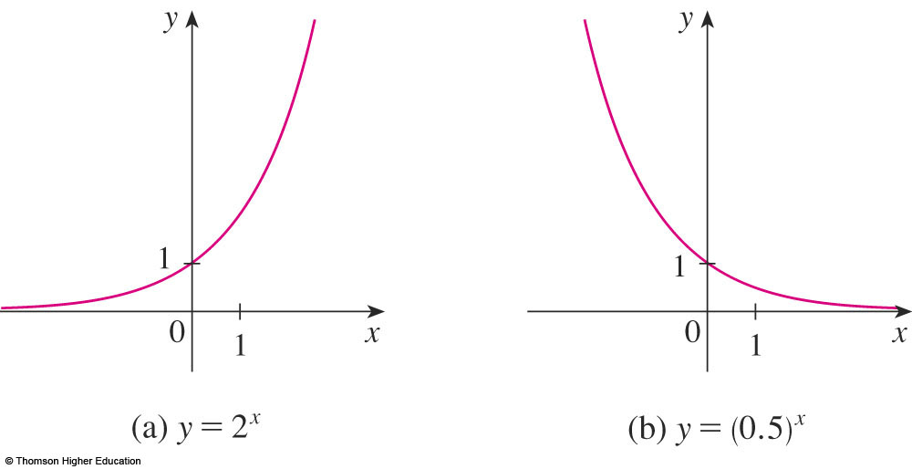
TRANSCENDENTAL FUNCTIONS
EXPONENTIAL FUNCTIONS
The exponential functions are the functions of the
form , where the base a is a positive constant.
  The graphs of y = 2^{x} and y = (0.5)^{x} are shown.
  In both cases, the domain is and the range
  is .
Notes:
Domain?
Range?
Graph when a>1; a<1

Slide 32
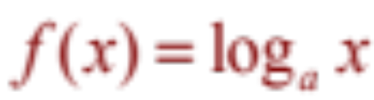
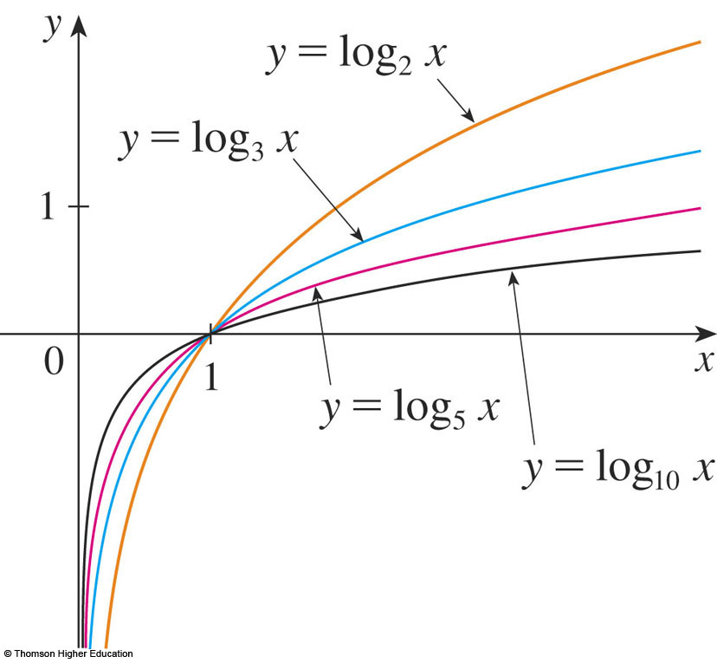
TRANSCENDENTAL FUNCTIONS
LOGARITHMIC FUNCTIONS
The logarithmic functions ,
where the base a is a positive constant, are the inverse functions of the exponential functions.
The figure shows the graphs of four logarithmic functions with various bases.
Notes:
0<a≠1; x>0

Slide 33

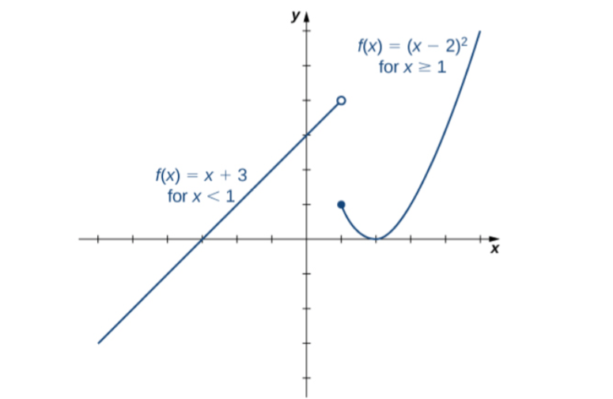
PIECEWISE-DEFINED FUNCTIONS
Example:

Slide 34
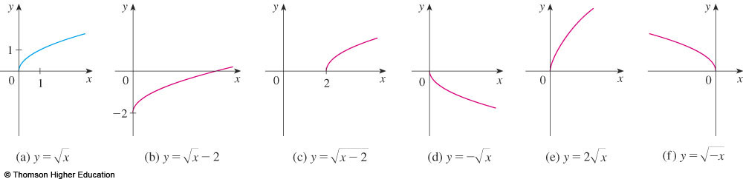
TRANSFORMATIONS OF FUNCTION
Label the following graph from the graph of
the function y=f(x) shown in the part (a)
y=f(x)-2, y=f(x-2), y=-f(x), y=2f(x), y=f(-x)?

Slide 35
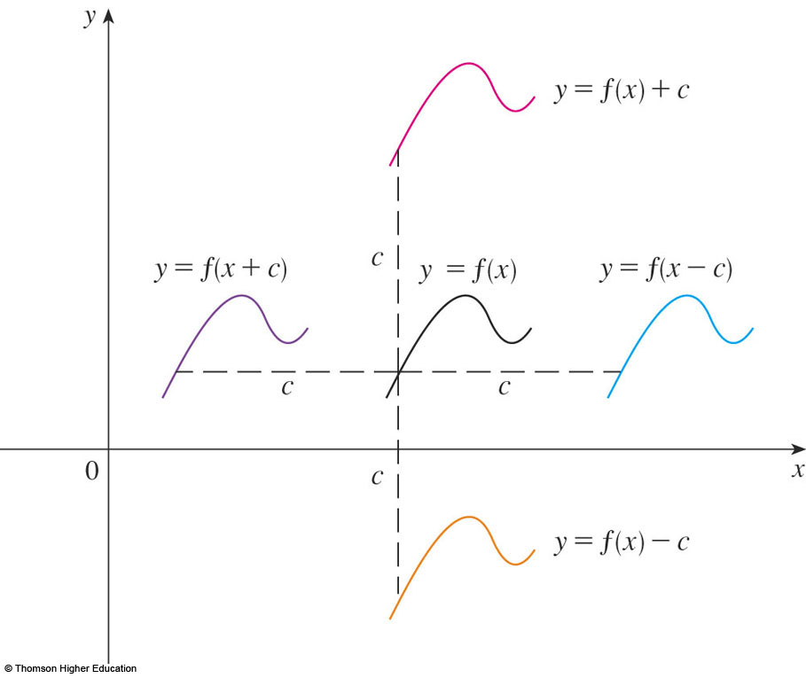
SHIFTING
Suppose c > 0.
  To obtain the graph of
  y = f(x) + c, shift the
  graph of y = f(x)
  a distance c units upward.
  To obtain the graph
  of y = f(x) - c, shift
  the graph of y = f(x)
  a distance c units
  downward.
Why don’t we consider the case c<0?
Notes:
f+c; f-c

Slide 36
SHIFTING
  To obtain the graph of y = f(x - c), shift the graph of y = f(x) a distance c units to the right.
  To obtain the graph
  of y = f(x + c), shift
  the graph of y = f(x)
  a distance c units to
  the left.
Notes:
x+c; x-c

Slide 37
NEW FUNCTIONS FROM OLD FUNCTIONS
Label the following graph from the graph of
the function y=f(x) shown in the part (a)
y=f(x)-2, y=f(x-2), y=-f(x), y=2f(x), y=f(-x)?

Slide 38
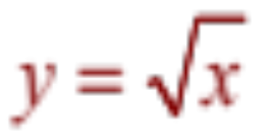
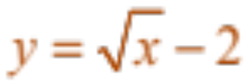
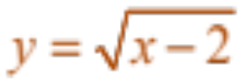
NEW FUNCTIONS FROM OLD FUNCTIONS
Label the following graph from the graph of
the function shown in the part (a):
y=f(x)-2, y=f(x-2), y=-f(x), y=2f(x), y=f(-x)?
by shifting 2 units downward.
by shifting 2 units to the right.

Slide 39
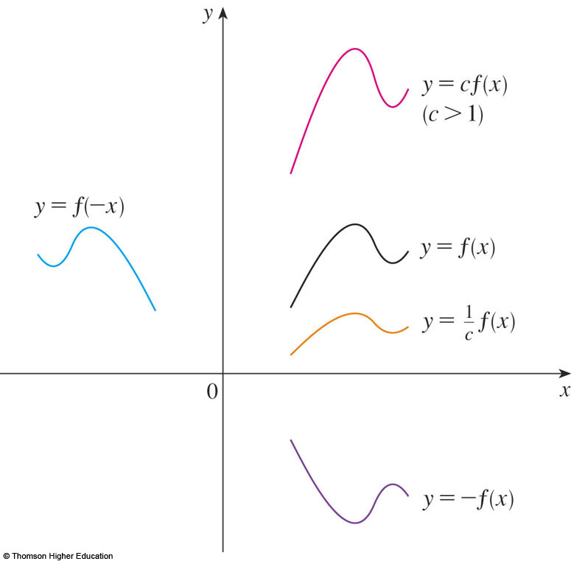
TRANSFORMATIONS
Suppose c > 1.
  To obtain the graph
  of y = cf(x), stretch
  the graph of y = f(x)
  vertically by a factor
  of c.
  To obtain the graph
  of y = (1/c)f(x),
  compress the graph
  of y = f(x) vertically by
  a factor of c.
How about the case c<1?
Notes:
f.c; f/c

Slide 40
TRANSFORMATIONS
  In order to obtain the graph of y = f(cx),
  compress the graph of y = f(x) horizontally
  by a factor of c.
  To obtain the graph
  of y = f(x/c), stretch
  the graph of y = f(x)
  horizontally by a factor
  of c.
Notes:
x.c; x/c

Slide 41
TRANSFORMATIONS
  In order to obtain the graph of y = -f(x),
  reflect the graph of y = f(x) about the x-axis.
  To obtain the graph
  of y = f(-x), reflect
  the graph of y = f(x)
  about the y-axis.
Notes:
y and –y symmetrically by Ox
x and –x symmetrically by Oy

Slide 42
NEW FUNCTIONS FROM OLD FUNCTIONS
Label the following graph from the graph of
the function shown in the part (a):
y=f(x)-2, y=f(x-2), y=-f(x), y=2f(x), y=f(-x)?

Slide 43
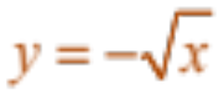
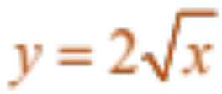
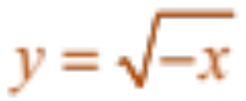
NEW FUNCTIONS FROM OLD FUNCTIONS
Label the following graph from the graph of
the function shown in the part (a):
y=f(x)-2, y=f(x-2), y=-f(x), y=2f(x), y=f(-x)?
  by reflecting about the x-axis.
  by stretching vertically by a factor of 2.
  by reflecting about the y-axis

Slide 44
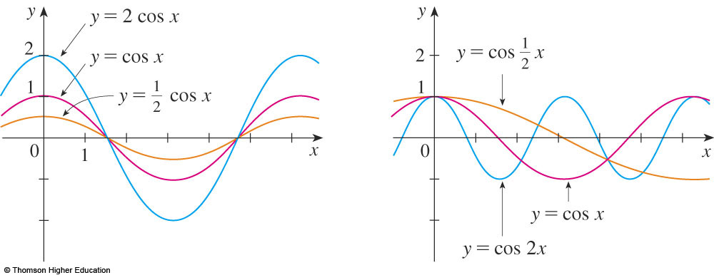
TRANSFORMATIONS
The figure illustrates these stretching
transformations when applied to the cosine
function with c = 2.

Slide 45
Example
Suppose that the graph of f is given.
Describe how the graph of the function f(x-2)+2
can be obtained from the graph of f.
Select the correct answer.
a. Shift the graph 2 units to the left and 2 units down.
b. Shift the graph 2 units to the right and 2 units down.
c. Shift the graph 2 units to the right and 2 units up.
d. Shift the graph 2 units to the left and 2 units up.
e. none of these
Answer: c

Slide 46

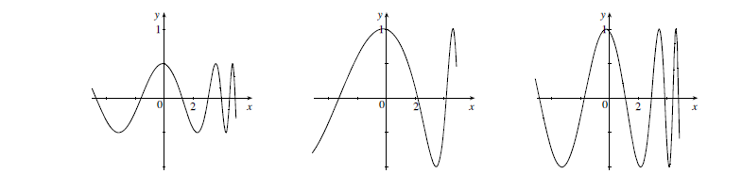
QUIZ QUESTIONS
Answer: ½ f(x), f(½ x), f(x)

Slide 47
Thanks

